Slide 1
Starry, Starry Fight? Supreme Court Justices Debate “Stare Decisis”
Lawrence S. Ebner
Washington, D.C.

Slide 2
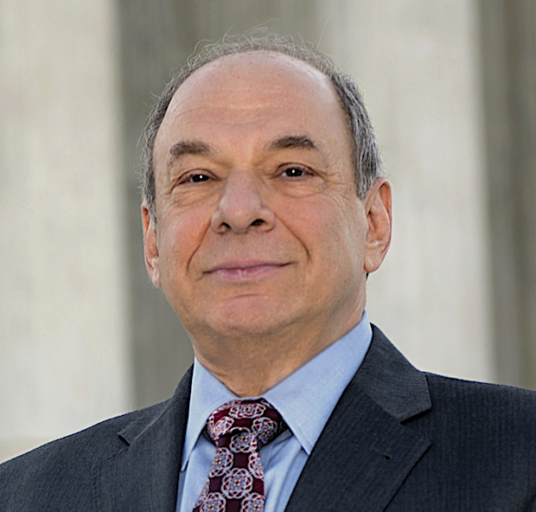
Larry Ebner
Nationwide appellate litigation practice
Departed BigLaw in 2016 to launch appellate litigation boutique,
Capital Appellate Advocacy PLLC
Almost 50 years of civil litigation experience; often teams with trial counsel when
cases go on appeal
Fellow, American Academy of Appellate Lawyers
Harvard Law School (1972) & Dartmouth College (1969)

Slide 3
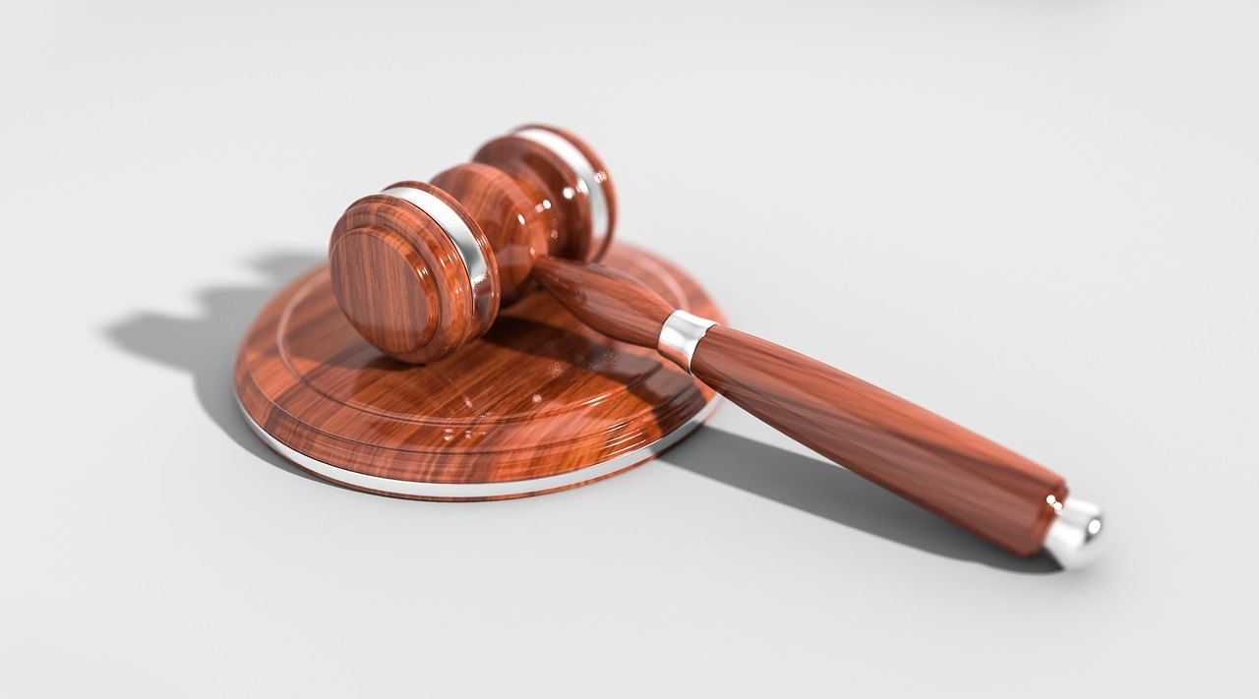
Stare Decisis – “Let the Decision Stand”
Stare decisis “promotes the evenhanded, predictable, and consistent development of legal principles, fosters reliance on judicial decisions, and contributes to the actual or perceived integrity of the judicial process.”
-- Payne v. Tennessee (1991)

Slide 4
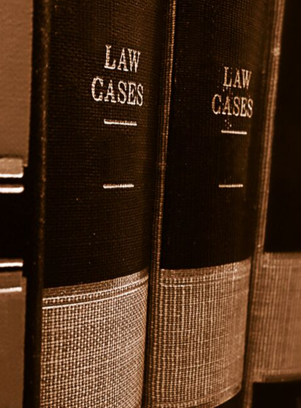
But –
What should be the criteria for the Supreme Court
overturning its own precedents?
Has stare decisis become an expedient for Justices
or litigants who want to retain deeply flawed precedent
for policy, political, or other reasons?
Four cases from last Term (Oct. 2018–Oct. 2019) illustrate
divisions among the Justices about the proper role &
application of stare decisis

Slide 5
Franchise Tax Bd. of Calif. v. Hyatt (2019)
5 to 4 decision overruling Nevada v. Hall (1979), which had held that the Constitution does not bar private suits against a State in the courts of another State
Justice Thomas’ majority opinion: “Stare decisis is not an inexorable command”
-- 3 factors to consider: (i) quality of decision’s reasoning, (ii) its consistency with related rulings, & (iii) legal developments since the decision
Justice Breyer’s dissent: “An argument that we got something wrong – even a good argument to that effect – cannot by itself justify scrapping precedent”

Slide 6
Gamble v. United States (2019)
7 to 2 decision authored by Justice Alito declining to overturn “170 years of precedent” about the “dual-sovereignty doctrine” (Double Jeopardy Clause does not prohibit federal & state prosecutions for the same conduct”)
Justice Thomas concurred, but stated: “When faced with a demonstrably erroneous precedent, my rule is simple: We should not follow it.”
Justice Gorsuch’s dissent: Although stare decisis “has many virtues . . . blind obedience to stare decisis would leave this Court still abiding grotesque errors”

Slide 7
Knick v. Township of Scott, Pennsylvania (2019)
5 to 4 decision overruling Williamson v. Hamilton Bank (1985), which had held that a Takings plaintiff must unsuccessfully seek just compensation under state law in state court before filing a federal Takings claim in federal court
Chief Justice Roberts’ majority opinion: Williamson should be overruled because (i) its “reasoning was exceptionally ill-founded,” it has “come in for repeated criticism” by Justices and legal scholars, and (iii) its state-litigation requirement “has proved to be unworkable in practice”
Justice Kagan’s dissent: “Williamson should stay on the books because of stare decisis . . . it is not enough that five Justices believe a precedent is wrong. Reversing course demands a special justification.”

Slide 8
Kisor v. Wilkie (2019)
Court unanimously limited – but declined to overrule -- Auer (1997) / Seminole Rock (1945) deference to federal agencies’ interpretations of their own ambiguous regulations
Justice Kagan’s lead opinion: Even if “Auer deference is wrong,” this case “does not offer the kind of special justification needed to overrule Auer . . . and “a long line of precedents – each one reaffirming the rest and going back 75 years”
Justice Gorsuch’s concurrence (only in judgment): “Today’s decision is more of a stay of execution than a pardon . . . a majority retains Auer only because of stare decisis . . . There are serious questions about whether stare decisis should apply at all”

Slide 9
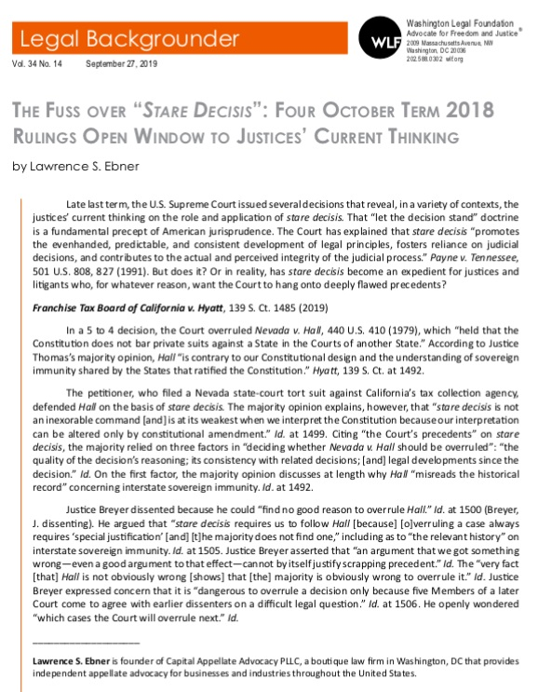
Want to learn more about
these cases?
CLICK HERE

Slide 10
Current Term
Seila Law v. Consumer Financial Protection Bureau
-- Will the Court overrule Humphrey’s Executor v. United States (1935) (involving the FTC) and agree with the Government that the CFPB is unconstitutional because its Director can only be fired by the President for cause?
Baldwin v. United States
-- Justice Thomas dissented from denial of certiorar in this case that would have revisited his own opinion in Nat’l Cable v. Brand X (2005) involving Chevron deference to an agency’s statutory interpretation after a court has interpreted the statute
-- “It is never too late to surrender former views to a better considered position”

Slide 11
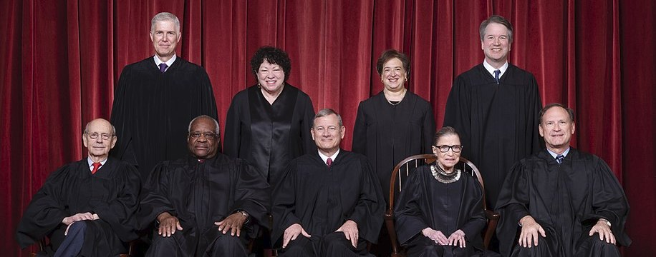
Takeaways
Some Justices appear to disagree about when stare decisis should prevent the overruling of cases
Justices Thomas’ & Gorsuch’s recent opinions suggest they believe that stare decisis is being applied too often to preserve bad precedent
Justices Breyer’s & Kagan’s recent opinions appear to advocate stricter adherence to stare decisis
Roe v. Wade is the “elephant in the courtroom” when it comes to stare decisis

Slide 12
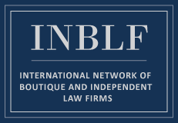
Call Me
If you have a question about practice or procedure in the Supreme Court or any federal court of appeals
If your case goes on appeal and you need appellate litigation assistance
If your client wants to file an amicus curiae brief in the Supreme Court or any other appellate court

Slide 13
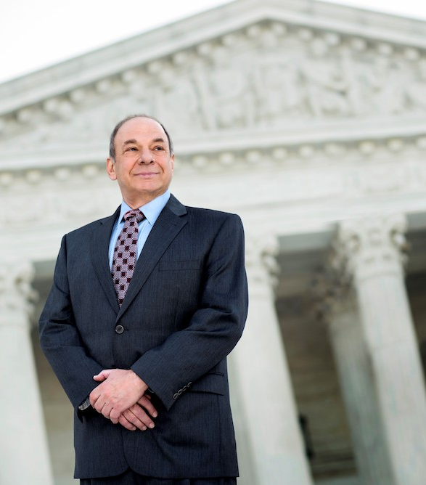
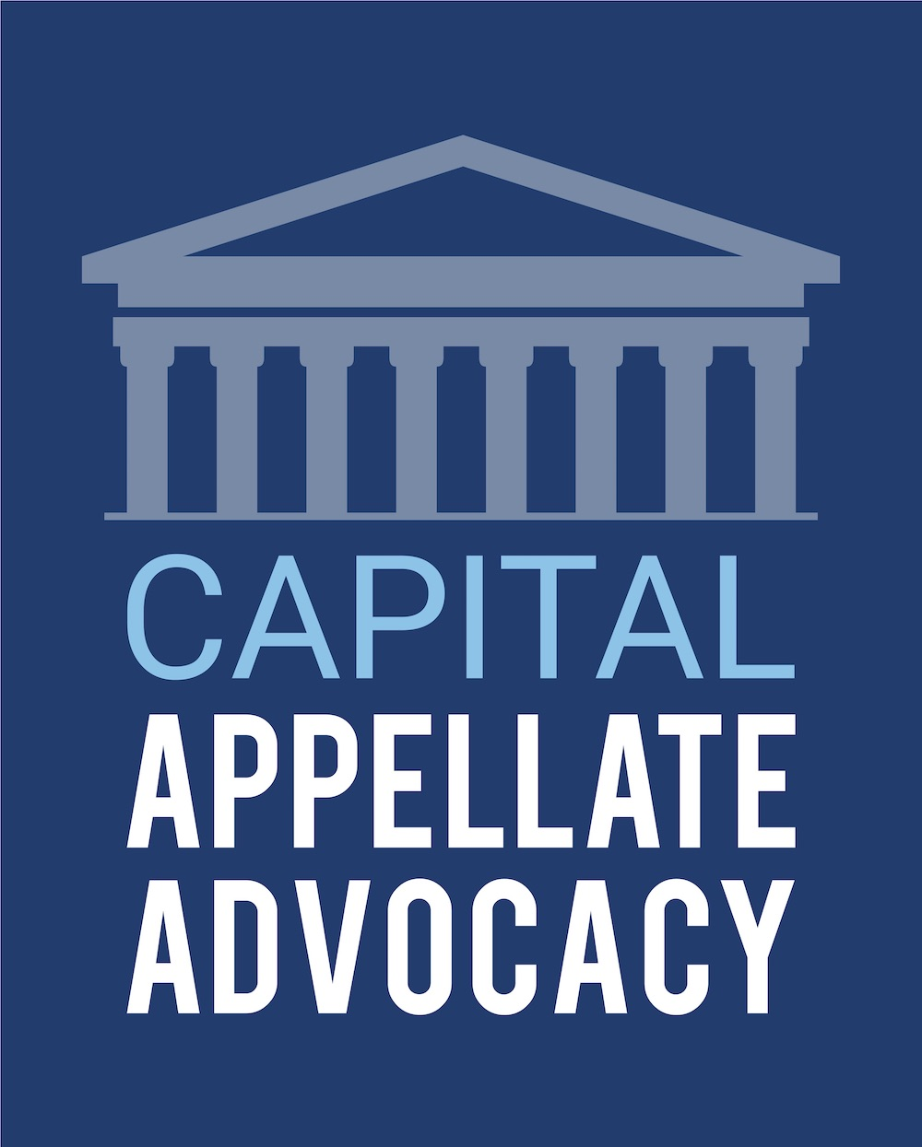
Larry Ebner
1701 Pennsylvania Ave NW, Suite 200 Washington, DC 20006
lawrence.ebner@capitalappellate.com
https://capitalappellate.com
linkedin.com/in/larryebner/
@Appellate_Atty
This Photo by Unknown Author is licensed under CC BY-SA

