Slide 1
Presenting a live 90-minute webinar with interactive Q&A
Strategic Use of Amicus Briefs
in Appellate Advocacy
Drafting Effective Amicus Briefs; Soliciting and Coordinating Amici Curiae;
Working With the Government as Amicus Curiae in Your Case
THURSDAY, OCTOBER 12, 2017
1pm Eastern | 12pm Central | 11am Mountain | 10am Pacific
  Today’s faculty features:
Lawrence S. Ebner, Founder, Capital Appellate Advocacy, Washington, D.C.
Averil Rothrock, Shareholder, Schwabe Williamson & Wyatt, Seattle
Mary-Christine (M.C.) Sungaila, Partner, Haynes & Boone, Costa Mesa, Calif.
The audio portion of the conference may be accessed via the telephone or by using your computer's speakers. Please refer to the instructions emailed to registrants for additional information. If you have any questions, please contact Customer Service at 1-800-926-7926 ext. 10.

Slide 2
Tips for Optimal Quality
FOR LIVE EVENT ONLY
Sound Quality
If you are listening via your computer speakers, please note that the quality
of your sound will vary depending on the speed and quality of your internet connection.
If the sound quality is not satisfactory, you may listen via the phone: dial
1-866-869-6667 and enter your PIN when prompted. Otherwise, please
send us a chat or e-mail sound@straffordpub.com immediately so we can address the problem.
If you dialed in and have any difficulties during the call, press *0 for assistance.
Viewing Quality
To maximize your screen, press the F11 key on your keyboard. To exit full screen,
press the F11 key again.

Slide 3
Continuing Education Credits
FOR LIVE EVENT ONLY
  In order for us to process your continuing education credit, you must confirm your participation in this webinar by completing and submitting the Attendance Affirmation/Evaluation after the webinar.
  A link to the Attendance Affirmation/Evaluation will be in the thank you email that you will receive immediately following the program.
  For additional information about continuing education, call us at 1-800-926-7926 ext. 35.

Slide 4
Program Materials
FOR LIVE EVENT ONLY
If you have not printed the conference materials for this program, please complete the following steps:
Click on the ^ symbol next to “Conference Materials” in the middle of the left-hand column on your screen.
Click on the tab labeled “Handouts” that appears, and there you will see a PDF of the slides for today's program.
Double click on the PDF and a separate page will open.
Print the slides by clicking on the printer icon.

Slide 5
STRAFFORD WEBINAR
STRATEGIC USE OF AMICUS BRIEFS
IN APPELLATE ADVOCACY
October 12, 2017

Slide 6
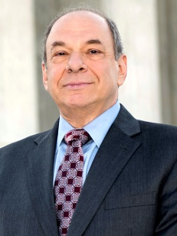


Panelists
Lawrence S. Ebner
Capital Appellate Advocacy PLLC
Washington, DC
lawrence.ebner@capitalappellate.com
Averil Rothrock
Schwabe Williamson & Wyatt
Seattle, WA
arothrock@schwabe.com
Mary-Christine (M.C.) Sungaila
Haynes & Boone
Costa Mesa, CA
mc.sungaila@haynesboone.com
6

Slide 7
OUTLINE/OVERVIEW
Introduction
Amicus Brief Requirements & Procedures
― Supreme Court of the United States
― Federal courts of appeals
― State appellate courts
Amicus Brief Strategy
― Identifying amicus brief opportunities
― Why, when, where, & how to seek amicus support
― Coordinating amici
  ― Style, approach, & content of an effective amicus brief at the petition & merits stages
  ― Amicus brief controversies
  United States as Amicus Curiae
7

Slide 8

INTRODUCTION: A BRIEF OVERVIEW OF THE HISTORY OF AMICUS ADVOCACY
Mary-Christine (M.C.) Sungaila

Slide 9
Amicus curiae literally means friend-of-the-court
Amicus briefs are filed on behalf of non-parties and are deeply rooted in our legal tradition
The first US amicus was filed in 1823 by Henry Clay in Green v. Biddle
Influential groups regularly filed amicus briefs in US courts by the late 1800’s
Today, the filing of amicus briefs is an accepted and expected part of appellate litigation practice
9

Slide 10

SUPREME COURT AMICUS BRIEF REQUIREMENTS & PROCEDURES
Lawrence S. Ebner
Capital Appellate Advocacy PLLC
Washington, D.C.

Slide 11
Supreme Court Rule 37 — Brief for an Amicus Curiae
Standard for Supreme Court Amicus Briefs [Sup. Ct. R. 37.1]:
“An amicus curiae brief that brings to the attention of the Court relevant matter not already brought to its attention by the parties may be of considerable help to the Court. An amicus curiae brief that does not serve this purpose burdens the Court, and its filing is not favored.”
Translation: The Court is not interested in receiving amicus briefs that merely repeat a party’s, or other amici’s, arguments.
11

Slide 12
Rules Governing Certiorari-Stage Amicus Briefs [Sup. Ct. R. 37.2]
Amicus briefs supporting the petitioner are due 30 days after the certiorari petition is docketed ― no extensions are allowed!
Amicus briefs supporting the respondent (rare!) are due when the respondent’s brief is due
Amicus counsel must provide written notice of intent to file to all counsel of record at least 10 days before the amicus brief’s due date (unless the amicus brief is filed more than10 days before the due date)
— Primary purpose is to allow the respondent to obtain an extension of time for preparation of response/opposition to petition
— Amicus brief must indicate that timely notice was provided
— Where multiple amici are on a brief, only one needs to provide notice
12

Slide 13
Rules Governing Certiorari-Stage Amicus Briefs (cont’d)
Unless all parties have provided consent to the filing of an amicus brief — either written consent to the filing of an individual brief or blanket consent to filing amicus briefs in support of either or neither party — a motion for leave to file must be incorporated into, and filed with, the amicus brief
— Where there are multiple amici on a brief, only one needs to request consent; letter requesting consent often combined with 10-day notice; counter-signed letter is lodged with Clerk
— Withholding of consent is disfavored
― The Court virtually never denies leave as long as an amicus brief is filed in a timely manner and adheres to the required format
— Leave is not required for U.S., State, or local government amicus briefs [Sup. Ct. R. 37.4]
13

Slide 14
Rules Governing Certiorari-Stage Amicus Briefs (cont’d)
Cert-stage amicus briefs must be printed in booklet format (cream cover); 6,000-word limit [Sup. Ct. R. 33]
― Beginning November 13, 2017 amicus briefs also must be filed & served electronically
― Further guidance available on the Supreme Court website
When in doubt, consult with your printer, who typically will file and serve an amicus brief for you
14

Slide 15
Rules Governing Merits-Stage Amicus Briefs [Sup. Ct. R. 37.3]
Amicus briefs “in a case before the Court for oral argument” are due within 7 days after the time allowed for filing the supported party’s brief (or if in support of neither party, within 7 days of the petitioner’s brief)
10-day notice of intent to file is not required
Unless individual or blanket consent has been granted, a motion for leave must be incorporated into the amicus brief
A merits-stage amicus brief must be printed in booklet format (light green cover for a brief supporting petitioner & dark green cover for a brief supporting respondent); 9000-word limit [Sup. Ct. R. 33]
Merits-stage amicus briefs must be filed and served electronically as well as in booklet form
15

Slide 16
Additional Rules Governing Supreme Court Amicus Briefs
One (and only one) counsel of record ― who is a member of the Supreme Court Bar ― must be identified on the cover of an amicus brief (name, office address, email address, telephone number) [Sup. Ct. R. 34(f)]
― Additional counsel for one or more amici also can be listed
Amicus briefs need only consist of :
― Interest of the Amicus (or Amici) Curiae
― Summary of Argument
― Argument
― Conclusion
[Sup. Ct. R. 37.5]
16

Slide 17
Additional Rules Governing Supreme Court Amicus Briefs (cont’d)
Amicus briefs must indicate in the first footnote on the first page of text –
“whether counsel for a party authored the brief in whole or in part and whether such counsel or a party made a monetary contribution intended to fund the preparation or submission of the brief, and shall identify every person other than the amicus curiae, its members, or its counsel, who made such a monetary contribution” [Sup. Ct. R. 37.6]
— Purpose of this disclosure is to deter parties from using amicus briefs as “page extensions”
— Rule does not preclude parties’ counsel from coordinating with amicus counsel, or commenting on draft amicus briefs
— Usually combined with statement re consent & confirmation of timely advance notice (at certiorari stage)
17

Slide 18

PRESENTED BY
Averil Rothrock
October 12, 2017
Amicus Briefs Requirements & Procedures: U.S. Federal Courts of Appeal

Slide 19
Standard for Briefs [FRAP 29]
For private parties, filing requires a motion for leave of court or consent by all parties. [FRAP 29(a)].
A party need not provide written evidence of consent, but simply represent that it has consent. [FRAP 29- Advisory Comm.]
Note: circuits may require an attempt to get consent. See Ninth Circuit Rule 29-3.
19

Slide 20
A Motion Must Include the Proposed Brief
The motion should state:
(1) the movant's interest; and
(2) the reason why an amicus brief is desirable and why the matters asserted are relevant to the disposition of the case.
20

Slide 21
Local Rules: Check Them!
They may:
Regulate the filing of amicus briefs.
Address or bar reply briefs.
Address amicus curiae in support of or opposing petition for panel or en banc rehearing (see, e.g., Ninth Circuit Rule 29-2). Could be disfavored if tactical. LaRue v. Dewolff, Boberg & Assocs., 458 F.3d 359 (4th Cir. 2006).
Address participation in oral argument (6th Cir.)
21

Slide 22
Local Rules: Check Them! (cont.)
Address standards. 5th Cir. (“…avoid repetition of facts or legal args contained in the principal brief and … focus on points either not made or not adequately discussed….”); 9th Cir. (on rehearing, only “when the post-disposition deliberations involve novel or particularly complex issues.”)
22

Slide 23
Local Rules: Check Them! (cont.)
On rehearing, not if would require recusal of judge (2nd Cir.)
Disclosure of 29(a)(4)(E) should appear in footnote on first page of brief (2nd Cir.)
23

Slide 24
Timing [FRAP 29(e)]
Seven days after the principal brief being supported is filed
Seven days after appellant/petitioner’s brief (if neutral)
Or later if leave is granted by the court
24

Slide 25
Oral Argument
FRAP 29 states that an amicus “may participate in oral argument only with the court’s permission.”
Check local rules. See 6th Cir. L.R. 29 (state “the reason oral argument will aid the court” in motion to participate).
Usually requires a party to share time with amicus.
25

Slide 26
District Courts: Amicus Allowed?
No circuit court decision on point.
According to the district courts, they have inherent authority to appoint or deny amici. Youming Jin v. Ministry of State Sec., 557 F.Supp.2d 131, 136 (D.C. Dist. 2008) (see internal citations; NJ and Texas); Am. Humanist Ass'n v. Maryland-National Capital Park & Planning Comm'n, 147 F. Supp. 3d 373 (D. Md. 2015); Wells Fargo & Co. v. United States, 2011 U.S. Dist. LEXIS 58365 (D. Minn.).
26

Slide 27
Amicus Impartial? District Courts:
Court considers “the presence of partiality.” Smith v. Chrysler Fin. Co., 2003 U.S. Dist. LEXIS 1798, 2003 WL 328719 (D.N.J.)
A “patently partisan amicus” may not be permitted. Sierra Club v. FEMA, 2007 U.S. Dist. LEXIS 84230, 2007 WL 3472851 (S. D. Tex.) (denying leave where interests and policy objectives were identical to those of the party whose position it sought to support).
“by the nature of things an amicus is not normally impartial and there is no rule that amici must be totally disinterested." Wells Fargo & Co. v. United States, 2011 U.S. Dist. LEXIS 58365 (D. Minn.)
27

Slide 28
Appellate Courts: 7th Circuit’s limited view
3 types of amicus: 1) when a party is not represented competently or at all, 2) when the amicus has an interest in a case that may be affected by the decision, or 3) presents unique information or perspective. “Otherwise, leave to file an amicus curiae brief should be denied.” Ryan v. Commodity Futures Trading Comm'n, 125 F.3d 1062, 1064 (7th Cir. 1997).
28

Slide 29
Appellate Courts: 7th Circuit’s limited view (Cont.)
The reasons for 7th Circuit’s policy are (1) the additional burden added by amicus curiae briefs to heavy caseloads, (2) suspicion that amicus curiae briefs are sought by parties to circumvent the page limitations, and (3) inject interest-group politics into the federal appellate process
  NOW, Inc. v. Scheidler, 223 F.3d 615, 616–617 (7th Cir. 2000).
29

Slide 30
More liberal, modern view:
Rejecting argument in opposition to amicus that an amicus must be an impartial person not motivated by pecuniary concerns. Neonatology Assocs., P.A. v. Comm'r, 293 F.3d 128, 130-31 (3d Cir. 2002) (Alito).
3 requirements implied by FRAP 29: an adequate interest, desirability, and relevance.
30

Slide 31
More liberal, modern view: (Cont.)
Courts should err on the side of accepting the brief "for what it is worth."
Amicus briefs which are unhelpful or fail to present unique information or which raise issues not addressed by the parties may be disregarded. Artichoke Joe's Cal. Grand Casino v. Norton, 353 F.3d 712, 719 n.10 (9th Cir. 2003)
31

Slide 32
How much consultation with parties?
Tenafly Eruv Ass'n v. Borough of Tenafly, 195 Fed. Appx. 93, 2006 U.S. App. LEXIS 22671(“they complain that appellants' attorneys spent time consulting with the amici in this case (which appellees seem to suggest is improper), but do not explain why this was inappropriate and not compensable.”).
32

Slide 33
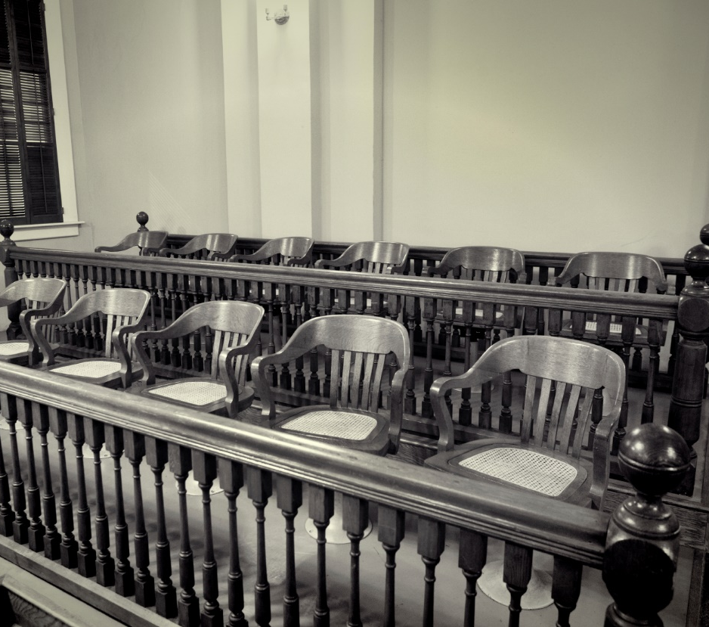
PRESENTED BY
Averil Rothrock
October 12, 2017
Amicus Brief Requirements & Procedures: State Appellate Courts

Slide 34
Procedures for Amicus Briefs
Individual court rules and common law should be consulted.
Possibilities include filing amicus briefs:
In trial court
To support discretionary review
At merits briefing stage in appellate courts
34

Slide 35
Example as to Trial Courts:
WA & CA
Trial courts have inherent authority to allow amicus briefs. Parsons v. State, 118 P.3d 930 (2005) (No rule permitting “but neither is there any rule prohibiting it.”). See also Arden-Oaks, 2011 Cal. App. Unpub. LEXIS 4614 (Cal. App. 3d Dist. June 21, 2011) (same), citing Cal. Code Civ. Proc. Section 128(a)(3).
Recommended to make motion for leave to file
Recommended to follow trial court civil rules and appellate rules as appropriate.
35

Slide 36
Examples as to Discretionary Review: WA & AZ
Wash. RAP 13.4(h). Amicus Curiae Memoranda allowed to support or oppose a pending petition for review; not later than 60 days from petition filing.
Ariz. R. Civ. App. P. R. 16. Amicus Curiae Brief in support of or opposing petition for review may be filed; 21 days.
36

Slide 37
Example as to Merits Briefing: WA
RAP 10.2 and 10.6:
Amicus brief not later than 45 days before oral argument if Supreme Court; within 45 days of respondent’s brief if Court of Appeals. Answer permitted by date fixed by court.
Motion states (1) interest, (2) familiarity with issues on review and scope of argument by parties, (3) specific issues addressed, (4) reason for additional argument on issues.
Objection permitted within five days.
37

Slide 38
Example As to Merits Briefing: AZ
Ariz. R. Civ. App. P.R. 16 (2016): A person may file an amicus brief with written consent by all parties, if a local government, or by permission if:
  if a party has incompetent/no representation,
  amicus has an interest in another case that the decision may affect, or
  amicus can provide information, perspective or argument that can help…beyond parties’ help
38

Slide 39
Whether to Object to an Amicus Submission
39

Slide 40
Can a party’s firm represent an amici, or have represented them in the past?
DirectTV, LLC v. Cordoba, No. 17-90020 11th Cir. 2017 (plaintiff’s attorneys objected to Chamber of Commerce’s amicus brief where DirectTV pays dues to Chamber and DirectTV’s lead attorney has represented Chamber in 50 cases, including cases where DirectTV filed amicus for Chamber).
40

Slide 41
www.reuters.com/article/us-otc-chamber-idUSKCN1B1237
“No one in 2017 seriously expects impartiality from frequent amicus filers like the Chamber– or from pro-plaintiffs advocacy groups on the other side.”
“The Federal Rules of Civil Procedure do not require disclosure of every connection between a proposed amicus and a party in the case, the Chamber reply brief said, including dues and outside counsel relationships.”
41

Slide 42
Should amicus be accepted in motion practice?
Amicus to support or oppose interlocutory review of FRCP 23(f) class certification?
42

Slide 43
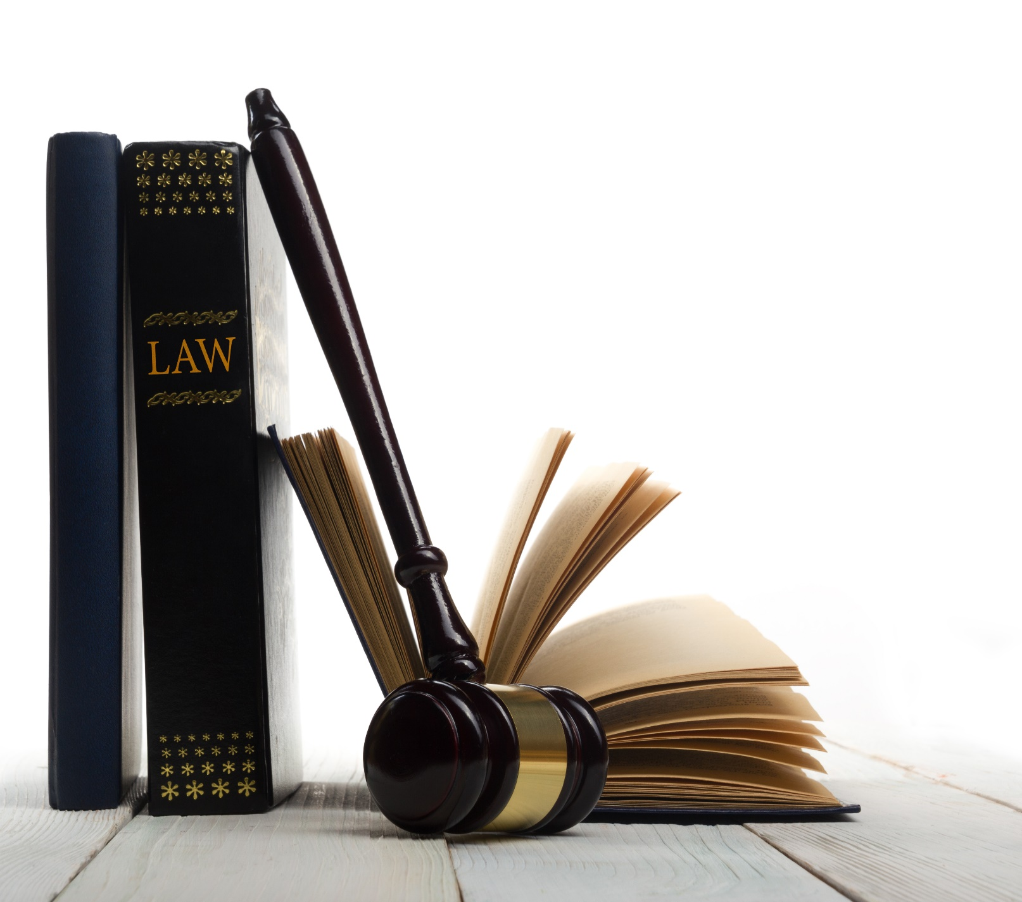
PRESENTED BY
Averil Rothrock
October 12, 2017
Elements of an Effective
Amicus Brief

Slide 44
Standard Elements for Merits Brief:
Statement of interest
Factual content: adding social science or other empirical data through reports, statistics, studies; historical information; context information; etc.
Supplemental legal arguments
Public policy arguments/implications of rulings
44

Slide 45
Technical Requirements: Check the Applicable Rules [e.g., FRAP 29(c)]
Disclosure statement (FRAP 26.1)
Table of contents
Table of authorities
Identity of amicus, interest, source of authority to file
45

Slide 46
Technical Requirements (cont.)
(5) Private party: must indicate:
(A) whether a party’s counsel authored the brief (not simply coordination)
(B) whether a party paid to fund $$ (payment of general membership dues not be disclosed)
(C) any other contributor $$
(6) Argument (summary and standard of review optional)
(7) Certificate of compliance (32(a)(7))
46

Slide 47
Strafford Webinar Program: Strategic Use of Amicus
Briefs in Appellate Advocacy
Soliciting and Coordinating Amicus Support
Mary-Christine “M.C.” Sungaila
949.202.3062
mc.sungaila@haynesboone.com

Slide 48
When to Solicit Amicus Briefs
Amicus briefs are most appropriately and frequently filed in cases before the highest court of the state or the U.S. Supreme Court. Once a case has reached this level, it raises policy issues well beyond the concerns of the individual parties to the case, and the court tasked with deciding the case will want to know the broader implications of the case beyond the parties. Amici can provide helpful guidance to the court about the real-world impact of any decision. Amicus briefs also may be helpful in a case that raises novel issues of law before an intermediate appellate court or a case as to which broader policy concerns are otherwise at issue. If the case impacts the individual parties and raises no broader issues, however, an amicus brief will not be helpful to the court (nor are you likely to convince an amicus organization to submit one)
48

Slide 49
Tips for Approaching Organizations About Amicus Support
Research the organization and its amicus procedures
Respect the organization’s time
Explain the broader implications of your case
Keep each organization in the loop about other organizations’ potential interest
Do not offer to offset the cost of the brief
49

Slide 50
Seeking Amicus Support From DRI-The Voice of the Defense Bar
Primary focus is Supreme Court; rarely federal courts of appeals; never state appellate courts
Completed Amicus Curiae Request Form must be submitted to DRI (amicus@dri.org) at least 45 days before an amicus brief is due
Requestor needs to identify the legal issues that it would like DRI address and explain why they re important to the civil defense bar, their clients, or the civil justice decision
9-member DRI Amicus Committee promptly reviews requests & must reach an affirmative consensus to proceed with a brief
Successful requestors must keep DRI notified of any significant developments that may affect preparation of amicus brief
50

Slide 51
Coordinating Amicus Support:
At the Discretionary Review Stage
At the petition or discretionary review stage: In order to convince a Supreme Court to grant review in a case, the most important factor amici-wise is to alert the court that groups well beyond the parties have an interest in the case and urgently need clarity and guidance on the law in that area. This may mean it is helpful for amici to further explore a circuit split on an issue and describe the real world impact of that continuing split. It may also mean, in a case where there is an issue of industry-wide importance but not yet a split of authority on the issue within a jurisdiction, having industry weigh in to explain the importance of and urgent need for clarity on the issue.
51

Slide 52
Who is the Audience and What Makes an Amicus Brief Successful?
Usually audience is clerks and/or judges.
Success in influencing opinion:
  providing factual fodder,
  providing context for application outside case,
  providing legal support not previously raised,
  providing legislative history
  = all to support desired result or analysis or to limit or enlarge scope of ruling
52

Slide 53
An Amicus Brief Should Add Something New
Remember the volume of briefing the justices/judges must read: would you like to read something that just repeats what’s already in the briefing?
What kind of facts can an amicus add?
53

Slide 54

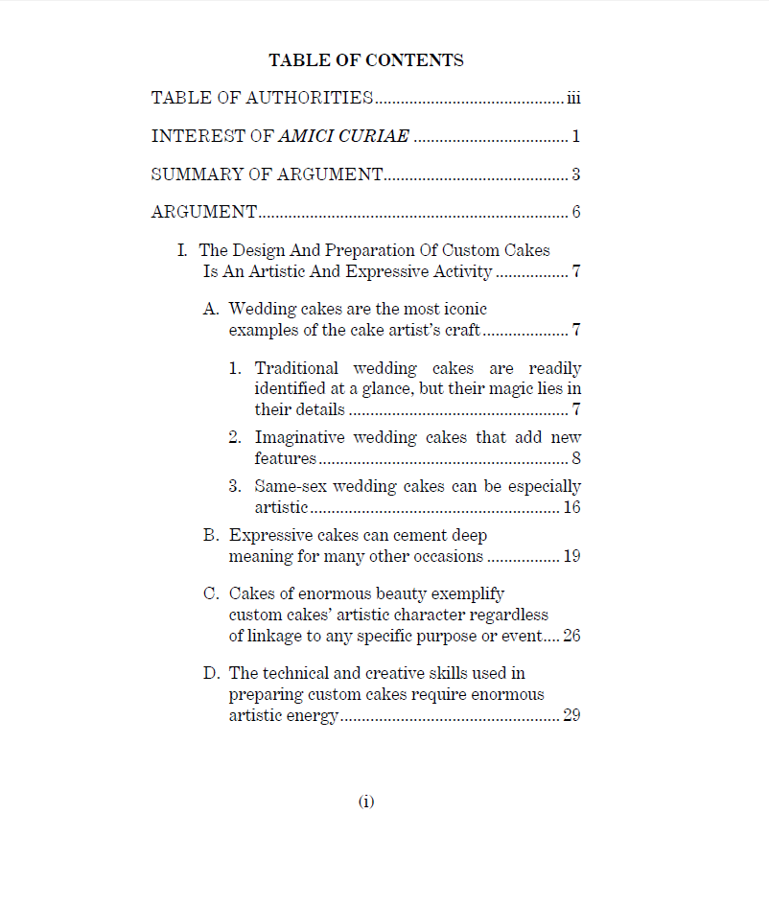

54

Slide 55
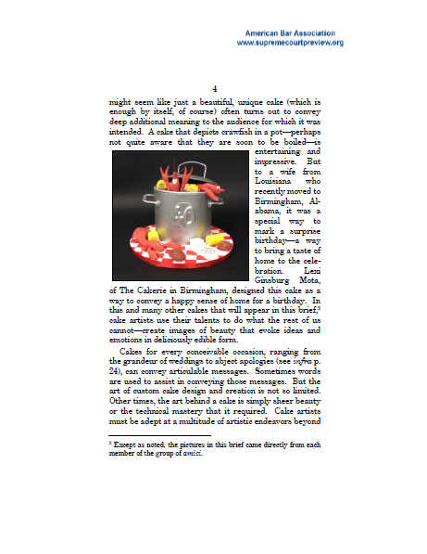


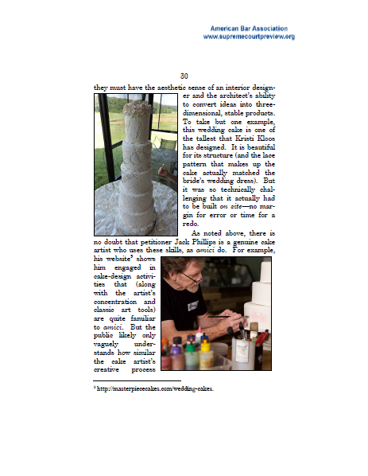
55

Slide 56
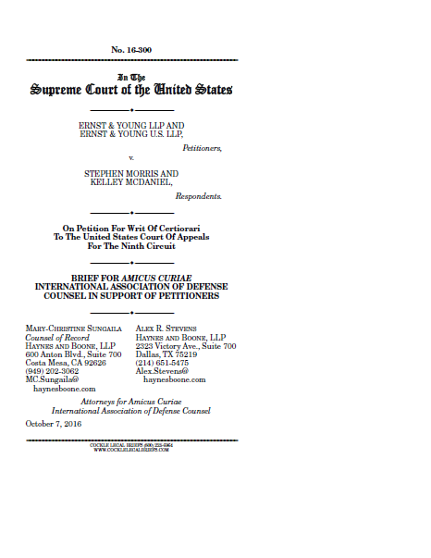
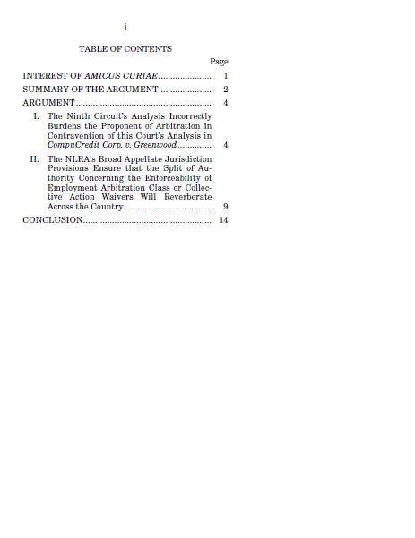
56

Slide 57
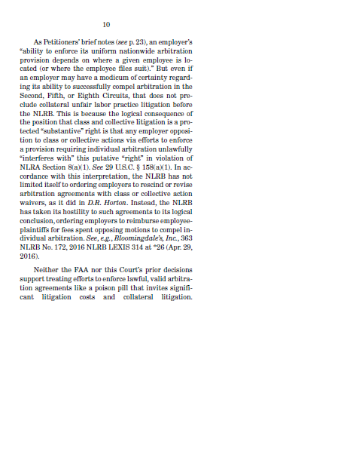
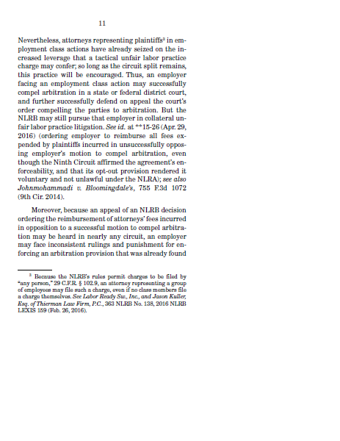
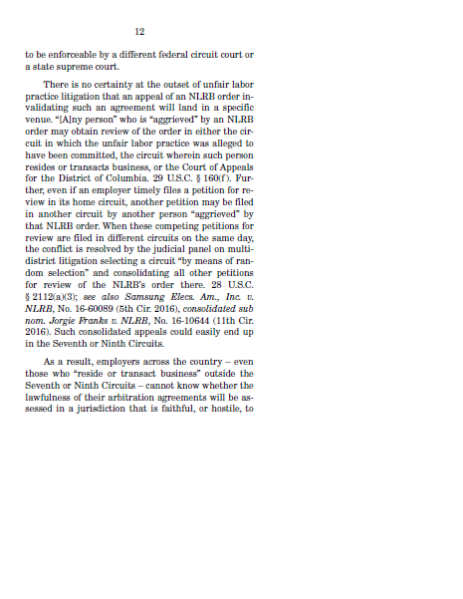
57

Slide 58
Amicus Brief Controversies
ACLU / “John Oliver Brief”
The All-Cartoon Amicus Brief
Connections Between Parties, Amici and Counsel
When are amicus briefs deemed sufficiently “helpful” for courts to accept them?
58

Slide 59
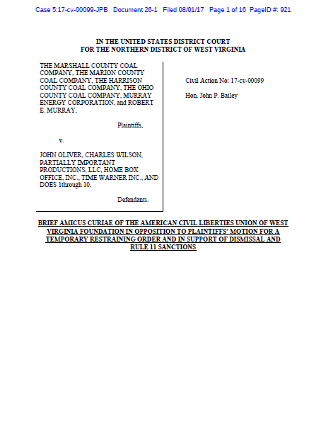
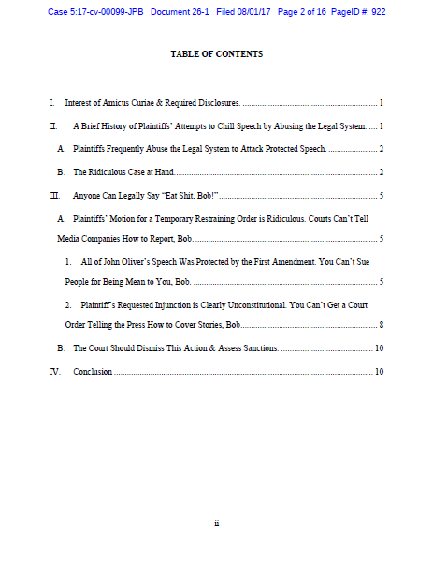
59

Slide 60
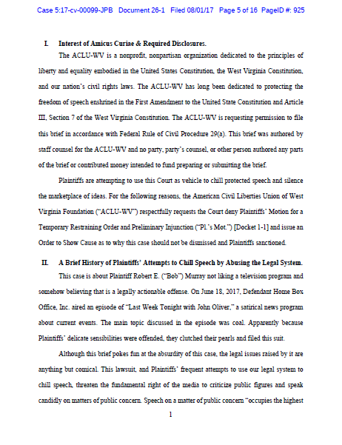
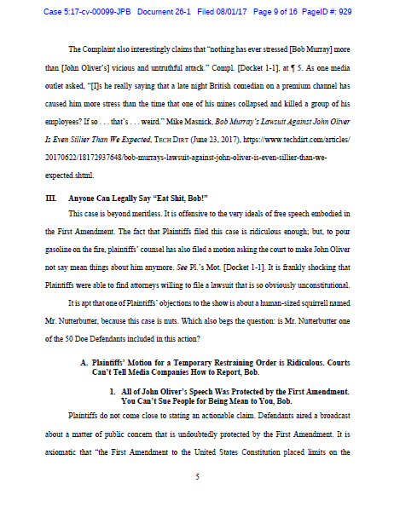
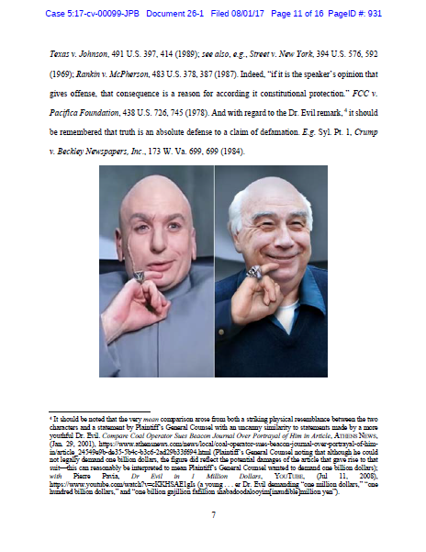
60

Slide 61
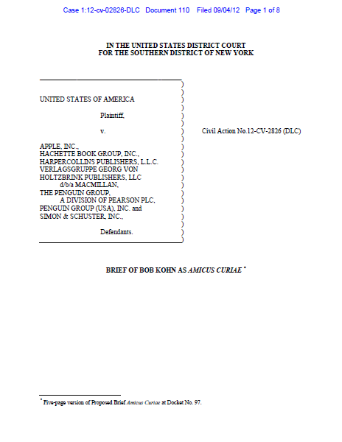
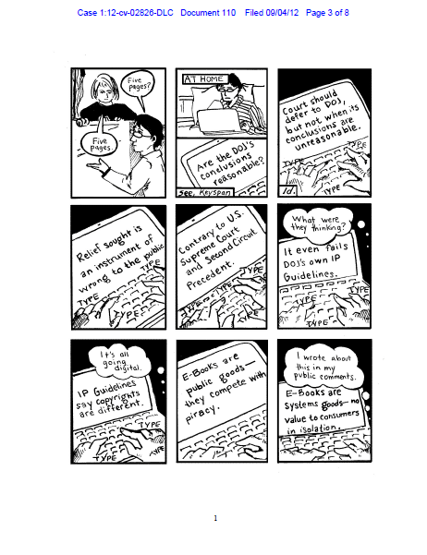
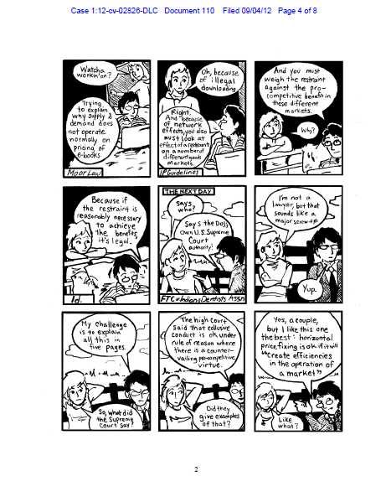
61

Slide 62
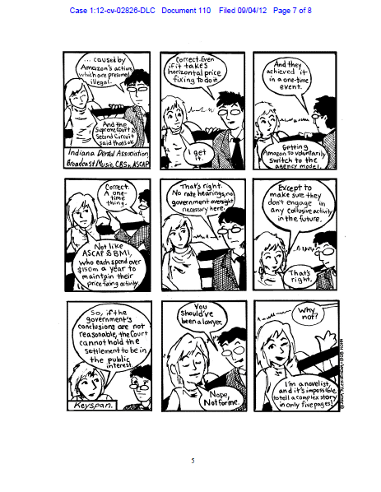
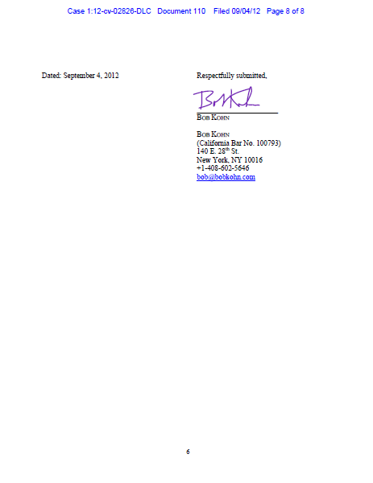
62

Slide 63
THE UNITED STATES AS AMICUS CURIAE
Lawrence S. Ebner
Capital Appellate Advocacy PLLC
Washington, D.C.

Slide 64
28 U.S.C. §517 (“Interests of the United States in pending suits”)
“The Solicitor General, or any officer of the Department of Justice, may be sent by the Attorney General to any State or district in the United States to attend to the interests of the United States in a suit pending in a court of the United States or in the court of a State.”
United States can file an amicus brief in the Supreme Court or in a federal court of appeals without parties’ consent or leave of court [Sup. Ct. R. 37.4; Fed. R. App. P. 29(a)]
Solicitor General’s Office writes & files Supreme Court amicus briefs; DoJ operating divisions (e.g., Civil Division) or certain independent agencies (e.g., FTC; SEC) file amicus briefs in the federal courts of appeals
Amicus brief word count & other format requirements apply — including statement of interest
Filing deadlines normally apply, but “CVSG” briefs are a major exception
64

Slide 65
“CVSG” Briefs
“CVSG” = “Call For the Views of the Solicitor General”
— issued by the Supreme Court after a certiorari petition, certiorari response, and amicus briefs have been filed and the Justices meet to discuss the case
— purpose of CVSG is to help the Court decide whether to grant certiorari
— SG’s Office fulfills an unofficial “gatekeeper” function
— Statistics show that SG’s recommendation is very influential
CVSG is issued in the form of an Order “inviting” the Solicitor General to file a brief expressing the views of the United States
— SG rarely files amicus briefs at the certiorari stage without first receiving a CVSG
— SG briefs are available online at SG website
65

Slide 66
“CVSG” Briefs (cont’d)
CVSG briefs discuss the merits of the questions presented, as well as whether or not certiorari should be granted
SG’s Office will take whatever time it needs to prepare a CVSG brief, and the Court will wait
— SG Office’s practice is to complete and submit all CVSG briefs during the Term in which it is requested
After the SG’s Office files a CVSG brief, the parties have an opportunity to promptly submit a supplemental brief responding to the SG’s brief
In cases where the Court issues a CVSG and then grants review, the SG’s Office normally files a merits-stage amicus brief and shares oral argument time with the party that the United States is supporting
66

Slide 67
Meeting with the SG’s Office After CVSG is Issued
Before filing a CVSG brief, the SG’s Office seeks early input from both sides (i.e., petitioner & respondent) as well as from all DoJ operating divisions & federal departments or agencies that have an interest in the case or the questions presented
SG’s Office meets separately with each side’s counsel, usually on the same day at the SG’s conference room in Main Justice
— Discussion led by one of the Deputy SGs & an Assistant to the SG
— Lawyers from interested DoJ operating divisions & interested federal departments and agencies also are in attendance
67

Slide 68
Meeting with the SG’s Office After CVSG is Issued
Each side should select one very well-prepared attorney to present their side’s views
— Be prepared for a very rigorous set of questions not unlike a Supreme Court hearing
After the each side presents, the government attorneys meet to discuss the case
Written memoranda can be submitted to the SG’s Office before and/or after the meeting (including from interested federal departments & agencies)
SG’s position is a “well-kept secret” until the day the CVSG brief is filed
68

Slide 69
You may also use the Chat function to ask questions, or email questions to litigation@straffordpub.com
CLE CODE: TXDNAG

Slide 71
Not A Passholder Yet?
Try the CLE Individual Annual Pass
Get all your CLE credits for one low price with the Strafford CLE Individual Annual Pass.
Attend unlimited live webinars in any of our legal practice areas where we produce over 600 advanced live webinars each year.
Plus you get unlimited access to hundreds of recorded webinars.
Simply respond to the email you will receive after the program.

